Slide 1
El hanooty
Yassin Sameh 23-101192
Omar Elsayed 23-101091
Yousuf Idrees 23-101077

Slide 2
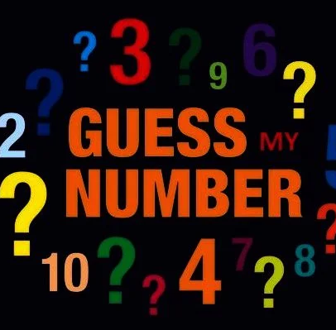
Guessing game
Welcome to the Number Guessing Game! In this fun game, one player thinks of a number, and others try to guess it. After each guess, you'll get a hint of whether it's too high, too low, or correct. The goal is to guess the number in as few tries as possible!

Slide 3
Way of playing
Step 1
Step 3
Set the range for the number (e.g., 1 to 100). The Thinker will choose a number within this range
After each guess, the game will provide hints such as
“Number is lower" if the guess is greater than the secret number.
“Number is higher" if the guess is less than the secret number.
“Good job" if the guess is the secret number.
Step 2
Step 4
The player guess a number within the specified range.
The game continues until the user guesses the correct number.
When the user guesses the number correctly before the specified attempts, he wins.

Slide 4



individual contributions
Flow chart, Presentation
C Code, Flow chart
C Code, Presentation

Slide 5
References
Chat GPT to help in the Random function.

Slide 6
Thank you
​

